Slide 1
Saforix Lithium titanate battery power take-off system Introduction

Slide 2
Contents
1
Product introduction
2
Battery projects
3
Market planning

Slide 3
Product introduction continue
01

Slide 4
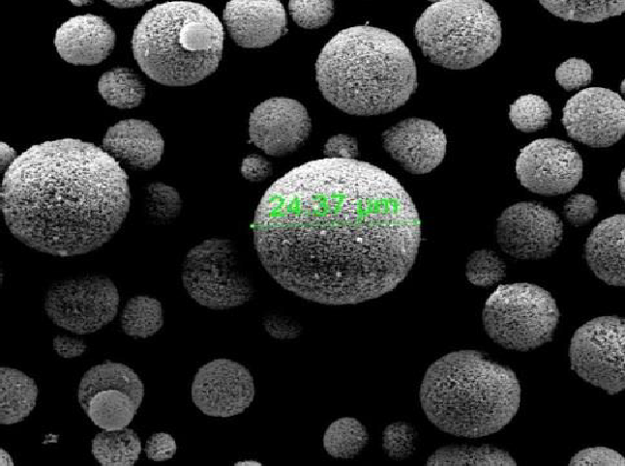
Company products
New energy battery
Excellent characteristics
High security
The only industrialized non-carbon anode, Maximum security Grade anode material
Long life
Lifespan ≥30,000 times
Fast charging
in the world The only fast chargeable negative electrode
（10C-6 min）
Lithium titanate (Li4Ti5O12) Anode material
Wide temperature operation
Excellent high and low temperature performance，
-50℃~65 ℃Normal charge and discharge

Slide 5
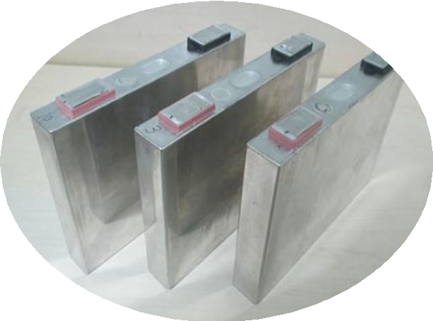
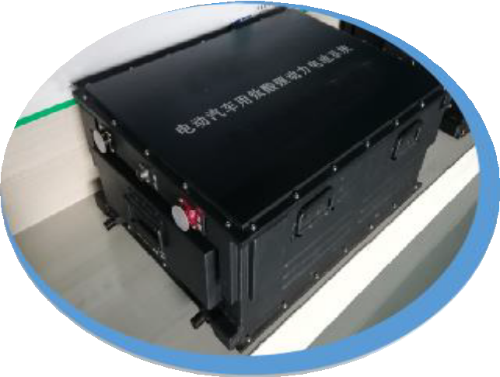
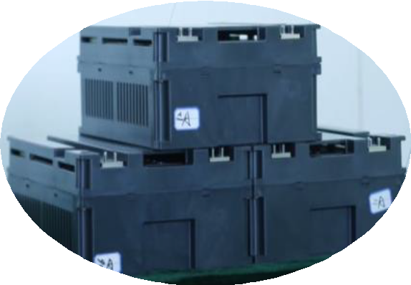
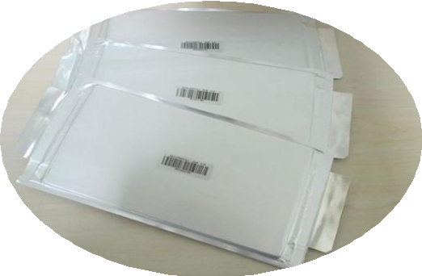
Company products
Pouch battery
Square aluminum case battery
Battery module
Power system

Slide 6
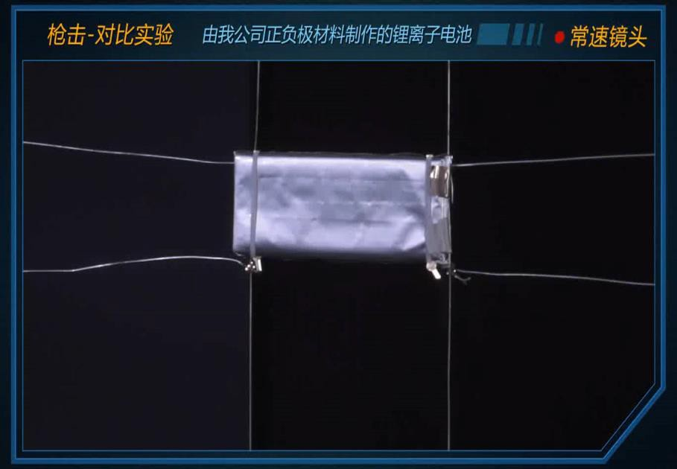
Product safety display

Slide 7
Product safety display

Slide 8
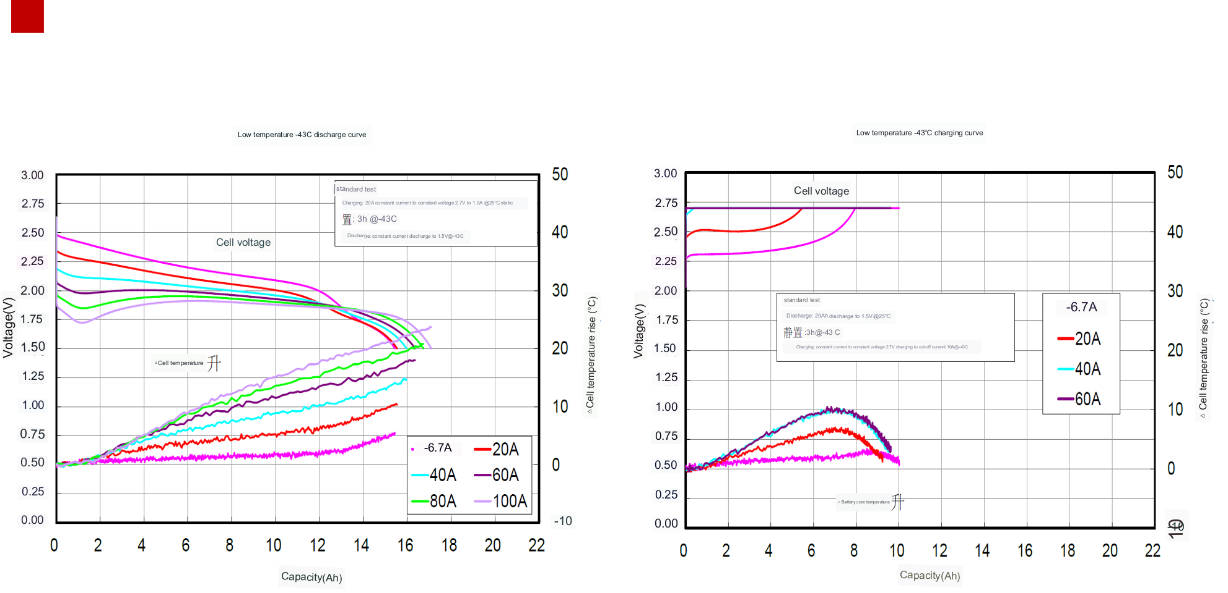
Low temperature discharge test data

Slide 9
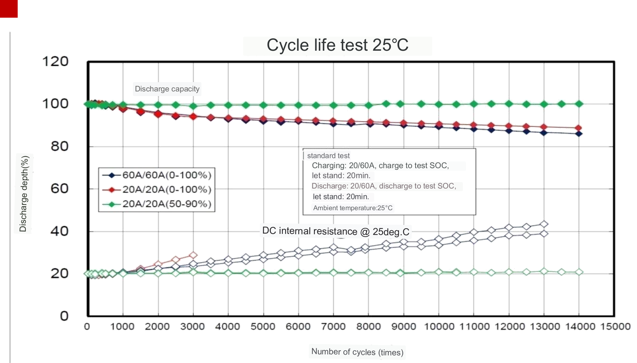
Cycle life

Slide 10
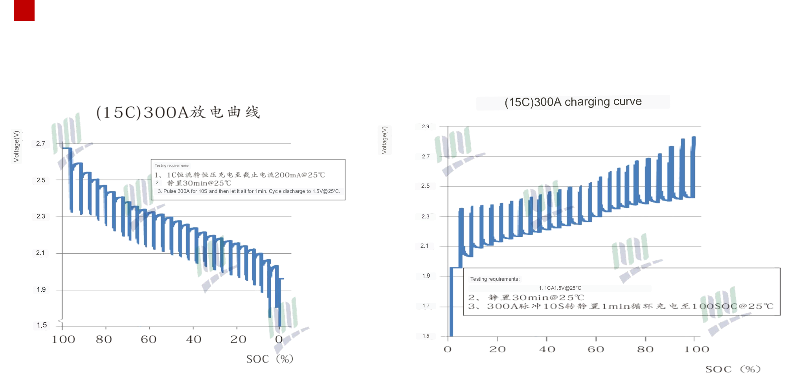
Rate pulse charge and discharge

Slide 11
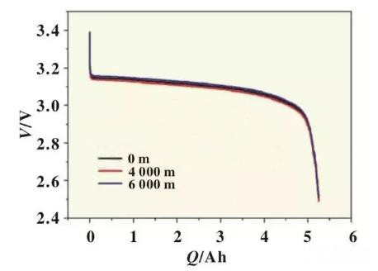
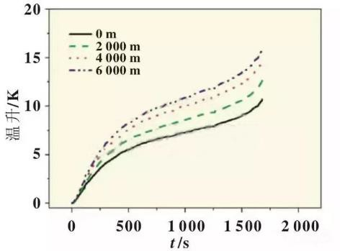
High-altitude low-pressure test
The conclusion of the 4000-meter high-altitude low-pressure test: the discharge current has no sharp edge, the voltage curve is normal, and the insulation is normal, but the heat dissipation performance is weakened during the battery charging and discharging。

Slide 12
Product advantages
Pool System Energy Density Service Life Fast charging capability |  |  |  | security
Lithium iron phosphate | 160Wh/Kg | 5000times | 1hour | Excellent
Ternary | 240Wh/Kg | 1500times | 1hour | Difference
Lithium titanate | 90Wh/Kg | 210,000 times | ≤10minute | Optimal
Lithium manganate | 170Wh/Kg | 2000times | 30minute | good

Slide 13
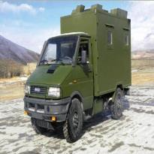
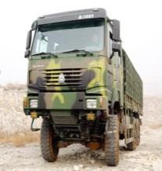
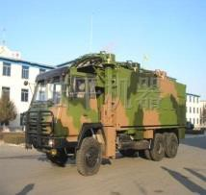
The company's products power take-off power generation system
Through the "multi-purpose of one machine" of vehicle engines, a power take-off power generation system is installed in the limited space of the chassis of Class II vehicles to output high-quality power that meets the requirements of superstructure equipment. This system is an important guarantee for the function of the bodywork equipment under field conditions. As a key subsystem for power support of military vehicle bodywork equipment in field situations, the vehicle-mounted power take-off power generation system has become an indispensable configuration for many new military vehicles with the advancement of the construction of the third-generation high-mobility military vehicle "weapons and equipment integration platform".

Slide 14
System classification and composition
Vehicle controller
Power take-off
Power frequency generator
Intelligent power distribution system
Parking power take-off power generation system
Power take-off power generation system
Wheel train transmission
High speed generator
Power Management Department
System power conversion
System battery pack
Vehicle power take-off power generation system

Slide 15
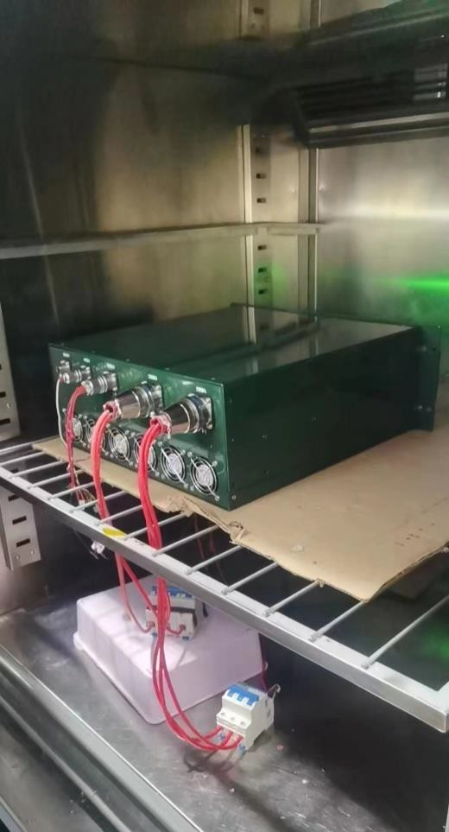
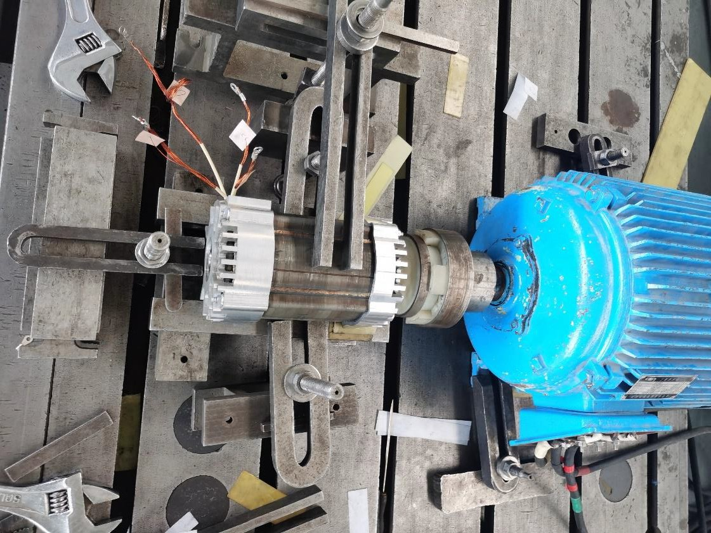
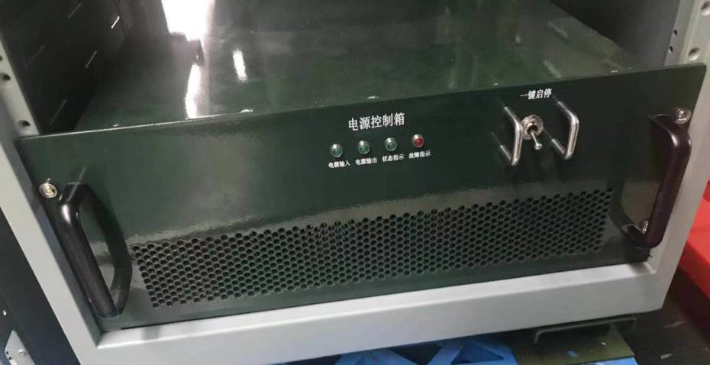
Power take-off power generation system
High-speed generator performance test
Power converter high and low temperature test

Slide 16
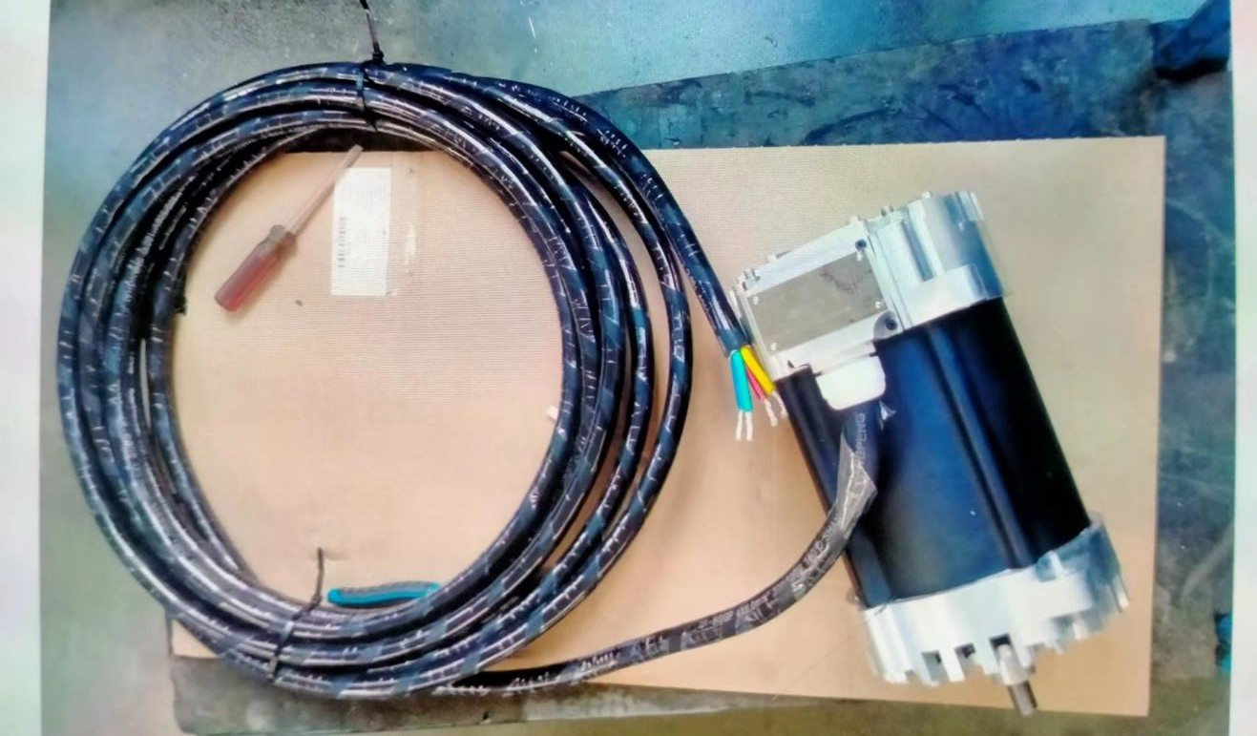
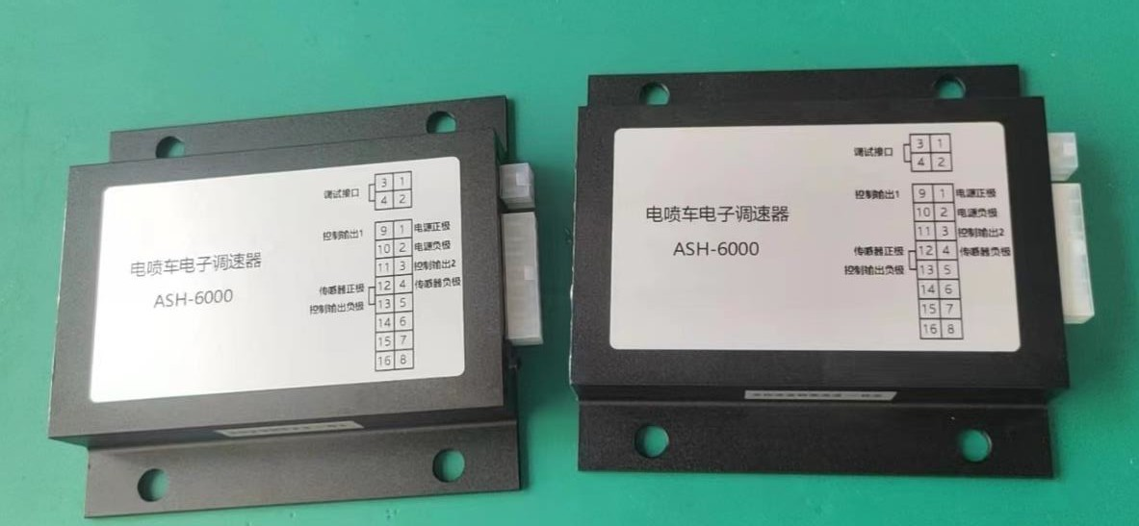
Power take-off power generation system
Vehicle controller
generator

Slide 17
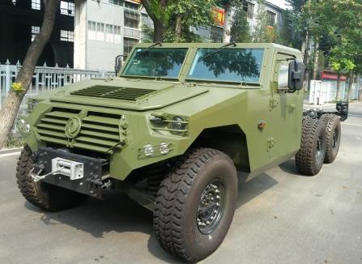
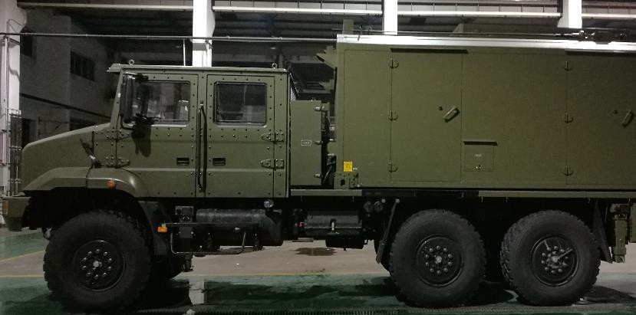
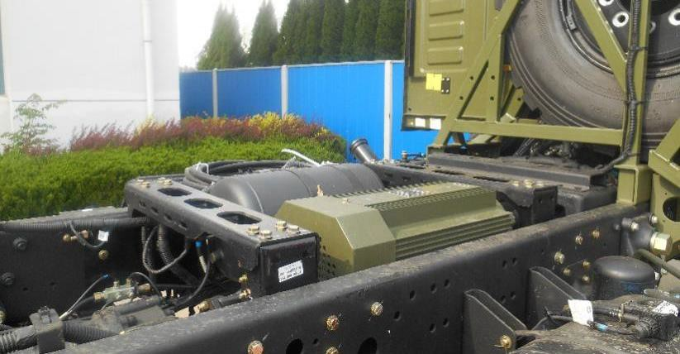
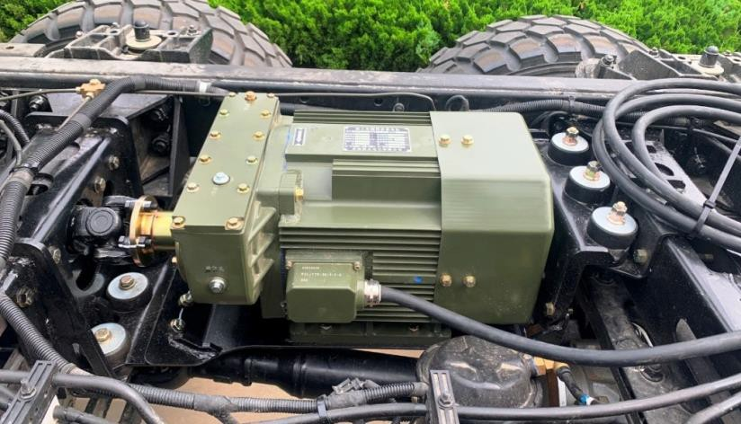
Power take-off power generation system
Parking power take-off power generation system
Mengshi - power take-off power generation system
Liberation - power take-off power generation system

Slide 18
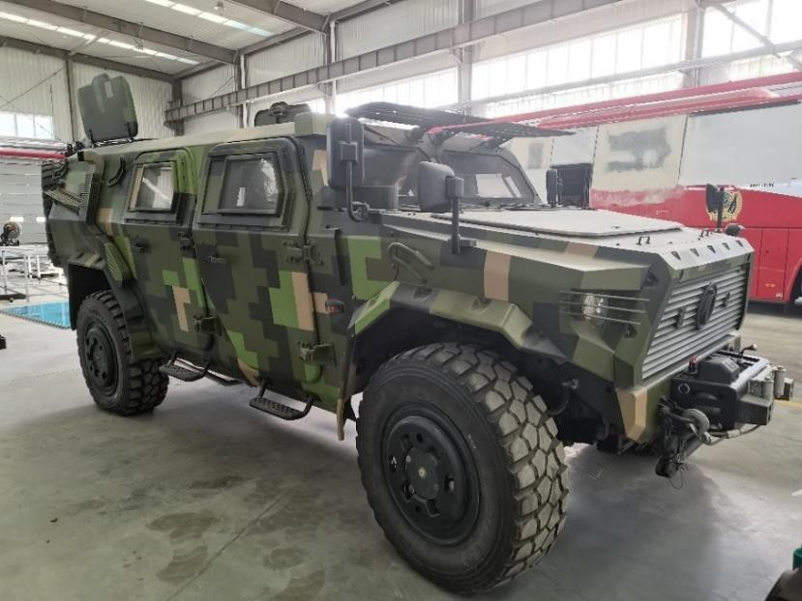
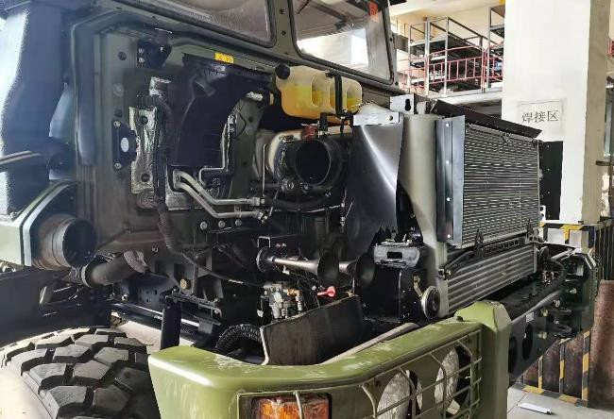
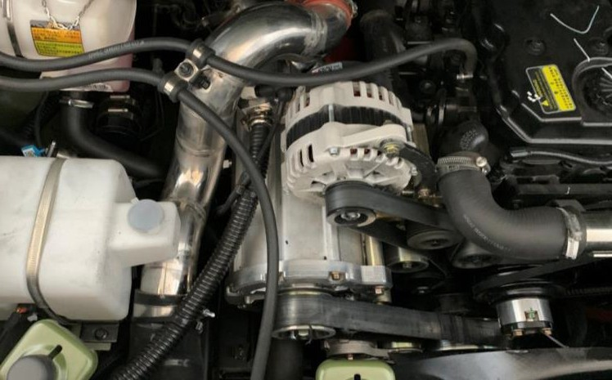
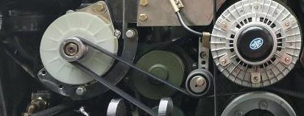
Power take-off power generation system
Vehicle power take-off power generation system
Mengshi - power take-off power generation system
Liberation - power take-off power generation system

Slide 19
Product advantages
In the past, diesel generator sets had shortcomings such as large size, heavy weight and cumbersome maintenance, which could not meet the requirements of lightweight, miniaturization and simplification of third-generation military equipment. The power take-off power generation system does not occupy the upper space, small size, light weight, no personnel waiting and waiting, etc., giving play to the role of the vehicle engine "one machine for multiple purposes", simplifying the structure of power generation equipment, reducing costs, using and maintaining simpler and more convenient, and fighters can master the operation in a short time. Improving the mobility and versatility of equipment has gradually been accepted by all branches of the military.

Slide 20
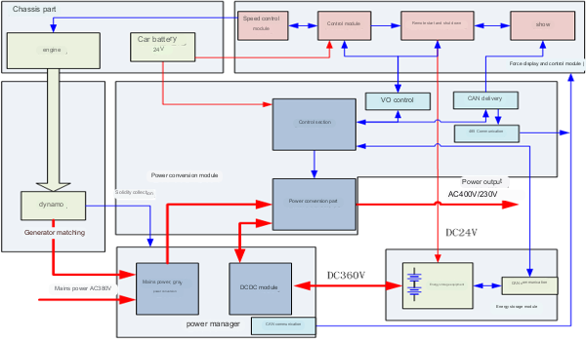
Product advantages
In the field of national defense and military, the power supply system covers land (army combat vehicles, military communication equipment, logistics support vehicles), sea (submarines, fuel tankers), air (anti-drone equipment, unmanned reconnaissance aircraft), and days (mobile satellite) and many other branches of the military. Field high-power power supply system has become an indispensable and important equipment for modern and future military equipment. Products of the Power Generation Division and products of the Battery Division The matching combination will provide one-stop service for on-board power supply for various types of vehicles and equipment of our army.

Slide 21
Battery projects
02

Slide 22
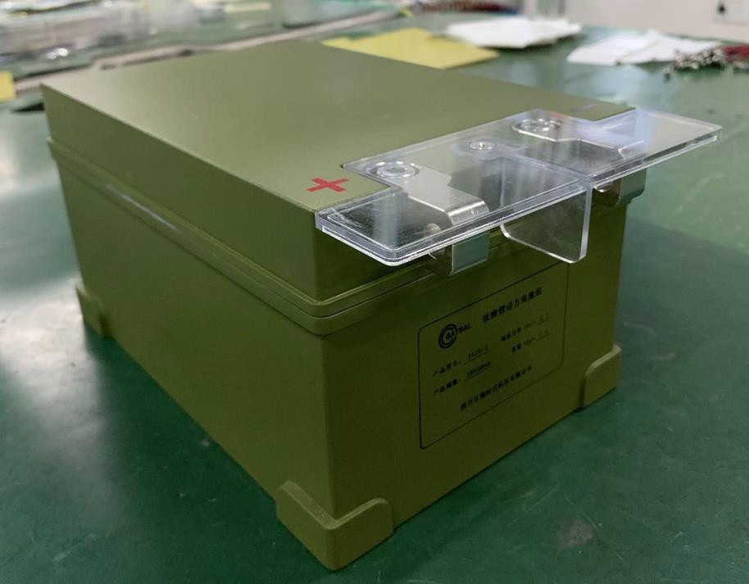
item 1 - finalized
serial number | name | parameter
1 | Capacitor system nominal voltage (V) | 28
2 | Nominal Capacity (Ah) | 20
3 | Total Charge (Kwh) | 9.6
4 | Series-parallel mode | 1 and 11 strings
5 | Maximum continuous discharge current（A） | 100
6 | Maximum continuous charging current（A） | 100
8 | Battery system size (mm) length * depth * height | 240*165*131
9 | Degree of protection | IP65
10 | Total system weight （Kg） | ≤7.2
The main technical parameters of the product

Slide 23
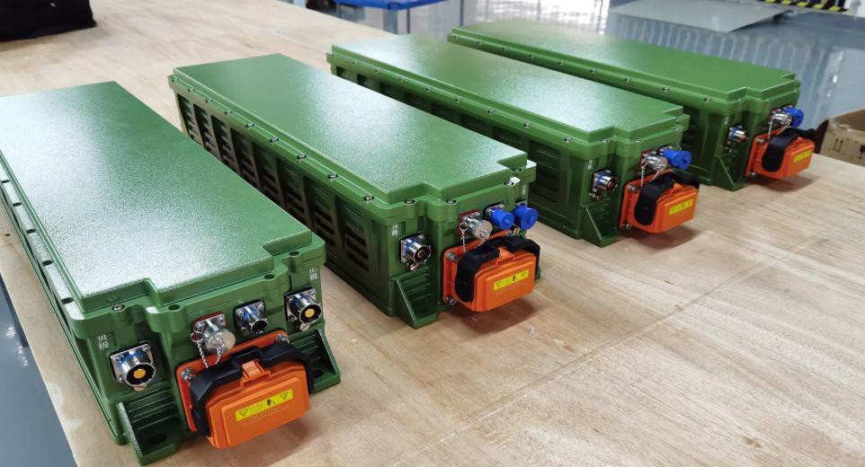
item 2 - finalized
serial number | name | parameter
1 | Capacitor system nominal voltage (V) | 325
2 | Rated Energy (Wh) | 65.8
3 | Total Charge (Kwh) | 3.22
4 | Series-parallel mode | 1 and 130 strings (supercapacitors)
5 | Maximum continuous discharge power (Kw) | 25
6 | Maximum continuous charging current (A) | 100
7 | Peak discharge power (Kw) | 40
8 | Battery system size (mm) length * depth * height | 780*210*160
9 | Degree of protection | IP67
10 | Total System Weight (Kg) | ≤22
The main technical parameters of the product

Slide 24
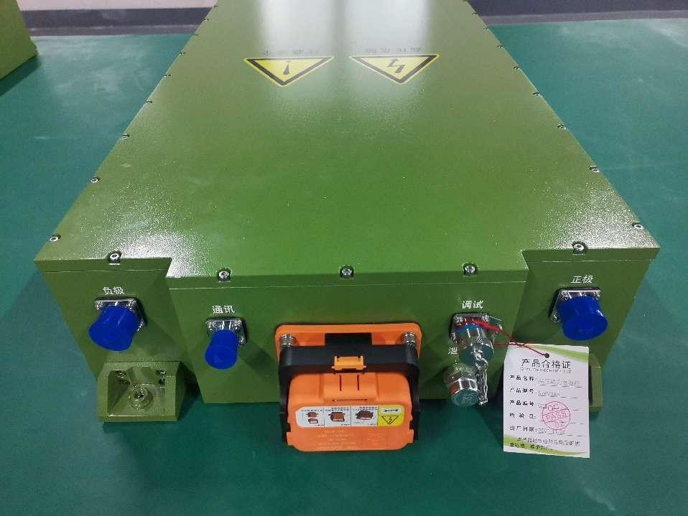
product item 3 - sample testing
serial number | name | parameter | remark
1 | Battery system nominal voltage (V) | 576
2 | Nominal Capacity (Ah) | 3
3 | Total Charge (Kwh) | 1.728
4 | Series-parallel mode | 1 and 240 strings
5 | Maximum continuous discharge current (A) | 60A | 20C continuous charge/discharge rate (room temperature)
6 | Maximum continuous charging current (A) | 60A | 20C continuous charge/discharge rate (room temperature)
7 | Battery system size (mm) length * depth * height | 891*420*135
8 | Degree of protection | ≥IP67
9 | Total System Weight (Kg) | ≤65
The main technical parameters of the product

Slide 25
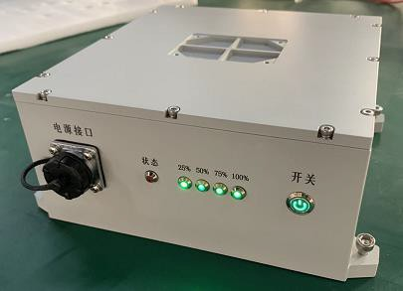
item 4 - sample testing
serial number | name | parameter
1 | Battery system nominal voltage (V) | 29.6
2 | Nominal Capacity (Ah) | 27
3 | Total Charge (Kwh) | 0.8
4 | Series-parallel mode | 9 and 8 strings
5 | Rated output power(W) | 350
7 | Battery system size (mm) length * depth * height | 190*200*90
8 | Degree of protection | ≥IP54
9 | Total System Weight (Kg) | ≤5
The main technical parameters of the product

Slide 26
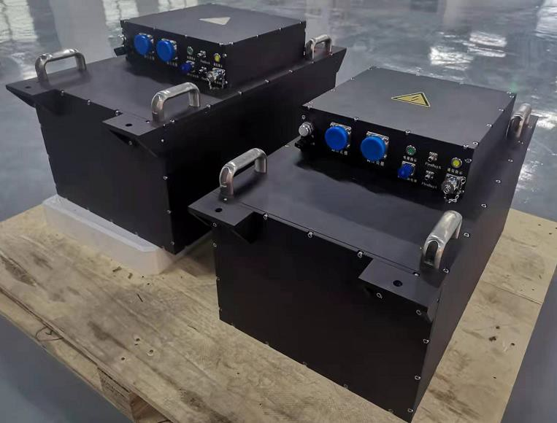
product project 5 - sample testing
serial number | name | parameter
1 | Capacitor system nominal voltage (V) | 600
2 | Nominal Capacity (Ah) | 16
3 | Total Charge (Kwh) | 9.6
4 | Series-parallel mode | 1 并 260 串
5 | Maximum continuous discharge current (A) | 160
6 | Maximum continuous charging current (A) | 160
7 | Peak discharge current (A) | ≥400A
8 | Battery system size (mm) length * depth * height | 716*508*465
9 | Degree of protection | IP67
10 | Total System Weight (Kg) | ≤175
The main technical parameters of the product

Slide 27
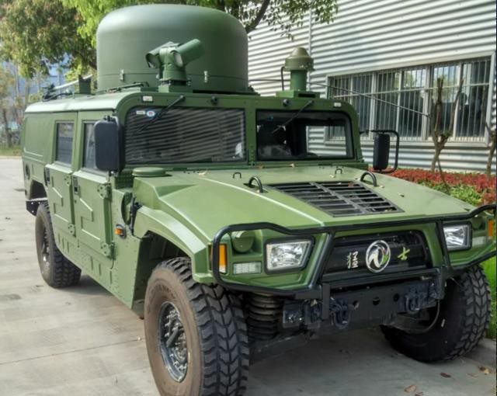
item 7 - sample testing
The Mengshi series chassis meets the 12kW parking power take-off power generation system
serial number | name | parameter
1 | Steady-state voltage regulation | ≤±1%
2 | Transient voltage regulation | ≤±15%
3 | Voltage volatility | ≤0. 3% voltage settling time ≤0.5s
4 | Steady-state frequency regulation | ≤± 0.5% transient frequency adjustment rate ≤±3%
5 | Frequency volatility | ≤0.25%
6 | Frequency stabilization time | ≤2s
7 | Voltage waveform distortion rate | ≤5% reliability index: MTBF≥3000h
The main technical parameters of the product
Two units of the 12kW power take-off power generation system are currently being installed at the customer's site and are planned8
Installation and testing of 40 sets will be completed by the end of the month.

Slide 28
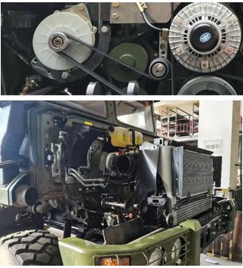
product project 8 - sample testing
In the FAW Jiefang series chassis, it meets the 3kW~30kW driving power take-off power generation system。
serial number | name | parameter
1 | Steady-state voltage regulation | ≤±1%
2 | Transient voltage regulation | ≤±15%
3 | Voltage volatility | ≤0.3% voltage settling time ≤0.5s
4 | Steady-state frequency regulation | ≤±0.5% Transient Frequency Regulation ≤±3%
5 | Frequency volatility | ≤0.25%
6 | Frequency stabilization time | ≤2s
7 | Voltage waveform distortion rate | ≤5% reliability index: MTBF≥3000h
The main technical parameters of the product
25kW drive-to-power generation system, currently the customer is in the planning stage, expected The prototype installation was completed in September 2022 and is expected to be completed in the first half of 2023 Mass production will be finalized in the second half of 2023 and more than 1,000 units are expected to be put into production。

Slide 29
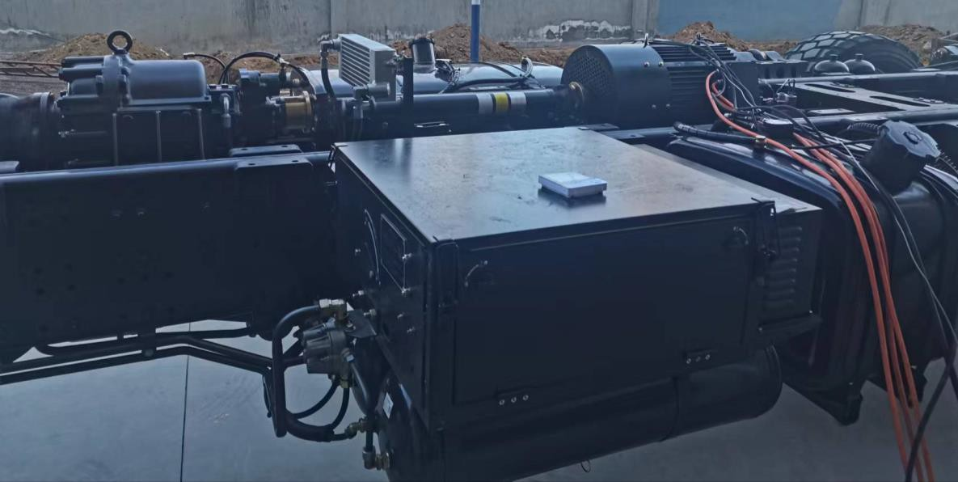
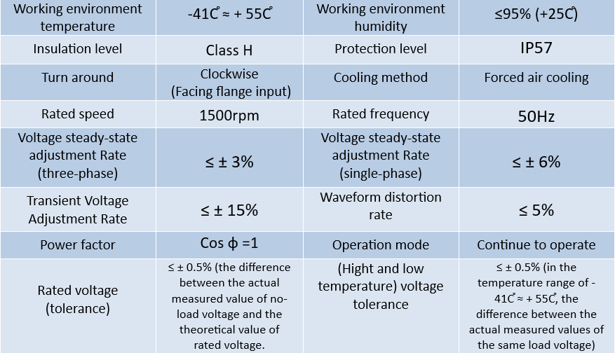
product project 9 - sample testing
Power take-off motor
Source: China Industrial Ordnance XX Research Institute
Project overview：
Special vehicles can be fully modified with a power take-off power generation system during driving/parking Full 100kW power supply, can be high-voltage DC/400V AC superstructure.

Slide 30
Market planning
03

Slide 31
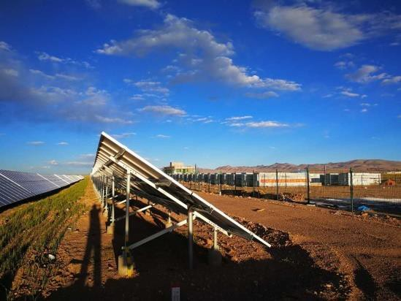
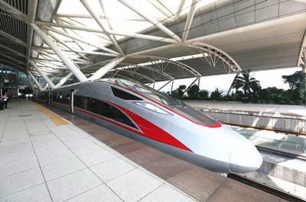
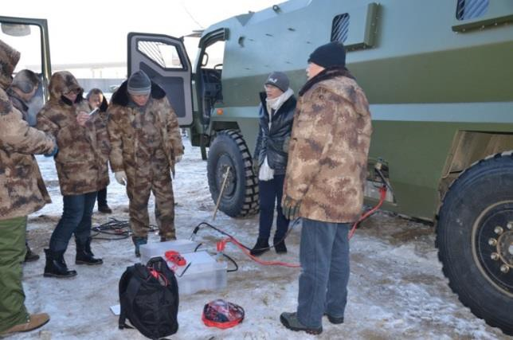
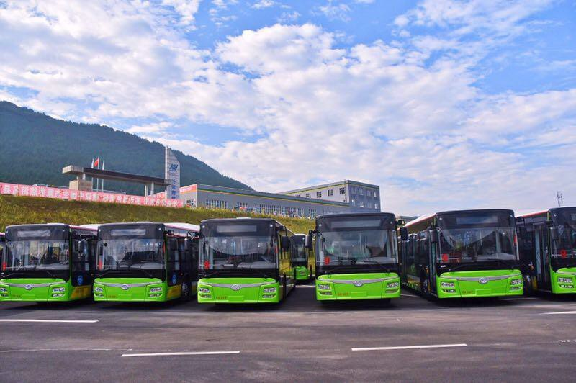
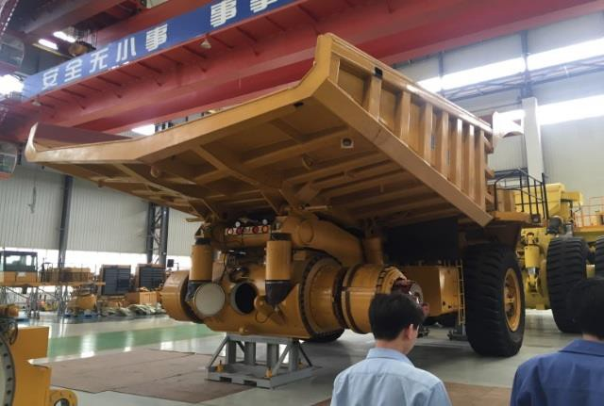
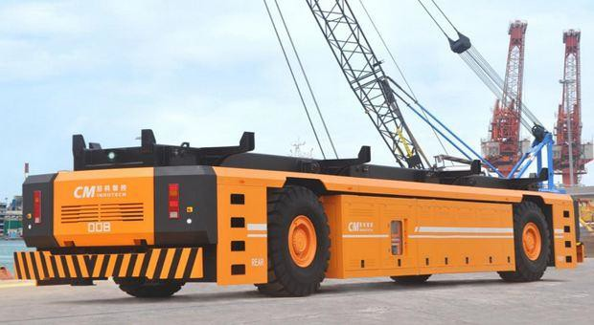
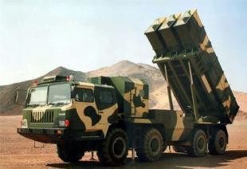
Market planning
Based on military products, make efforts to civilian products
Energy storage frequency regulation power supply
Train traction Energy storage power supply
Military power and starting power
BRT bus power supply
Minecart power supply
HAECO power supply
Logistics support vehicles
Accompanying covered vehicle
Main combat vehicle

Slide 32
Thanks
www.Saforix.com
www.myptechnology.com

