Slide 1
Introduction of kWh outdoor power supply
M Y P Technology Limited
Let green energy better integrate into life and serve society

Slide 2
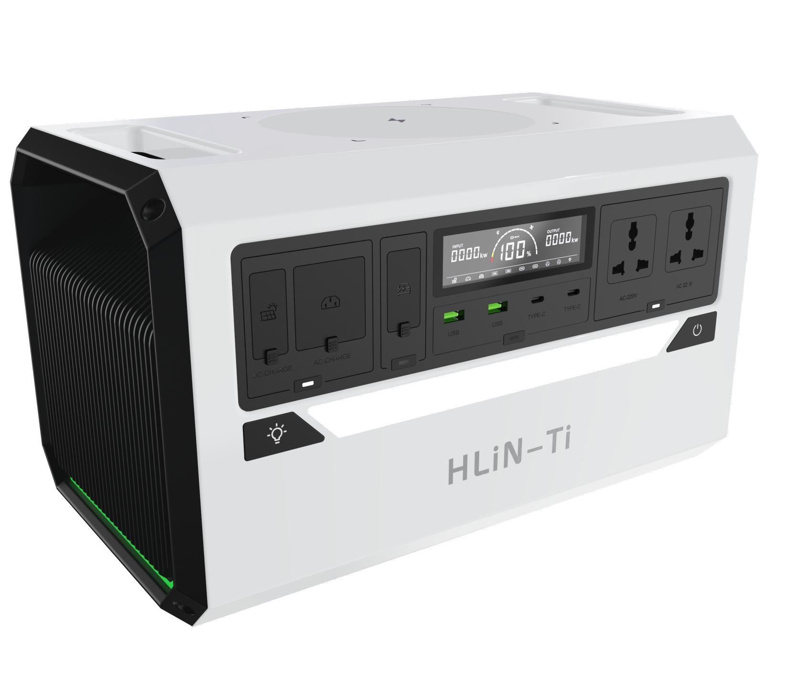
Technology Center
Convenient outdoor power supply product introduction
Introduction to the performance of outdoor power supply products
serial number | name of the product | Function introduction
01 | Model | HW-1124
02 | Single battery indicators | 2.3V / 49Ah
03 | Module design metrics | 25.3V / 1239.7Wh
04 | Output function | AC2000W*2 / USB*2 / Type - C*2 / 24V Emergency start-up /15W illuminating / cell phone15W Wireless charging
05 | Input function | Mains 1500W / 200W Solar / Hand 40W (Max)
06 | Applicable temperature | -45~60℃
07 | Cycle life | Number of cycles≥ 20,000 (30 years of cycles)
08 | Module size | L*W*H 400*230*230mm
09 | wight | 14.5KG

Slide 3
THANKS
www.Saforix.com
www.myptechnology.com

